Slide 1

JOB SHADOWING IN ANTALYA

Slide 2
Hotel is located in Konyaaltı district. Hotel is also very close (300 m) to the beach. Students are in double/triple rooms, teachers are in single rooms.
GÜLİZAR HOTEL FOR ACCOMMODATION

Slide 3
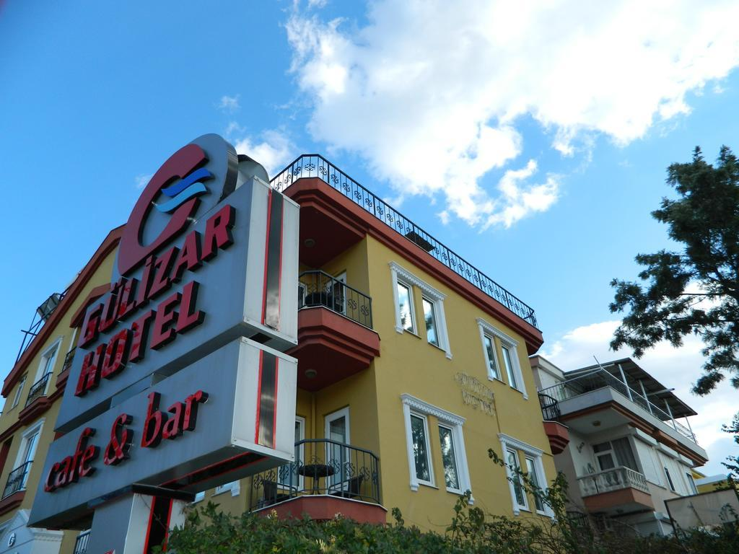
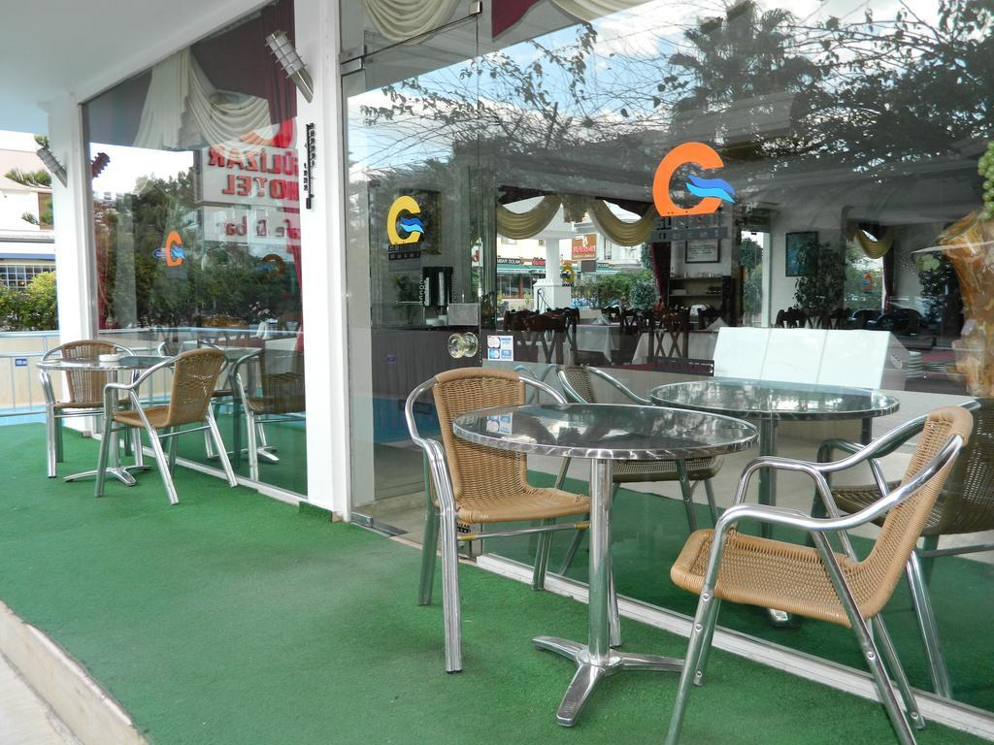

Slide 4
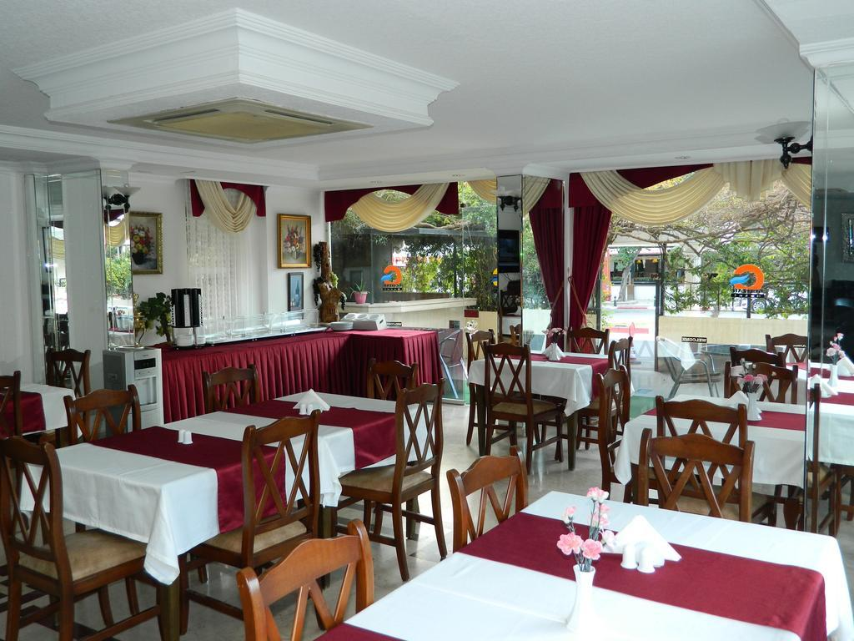
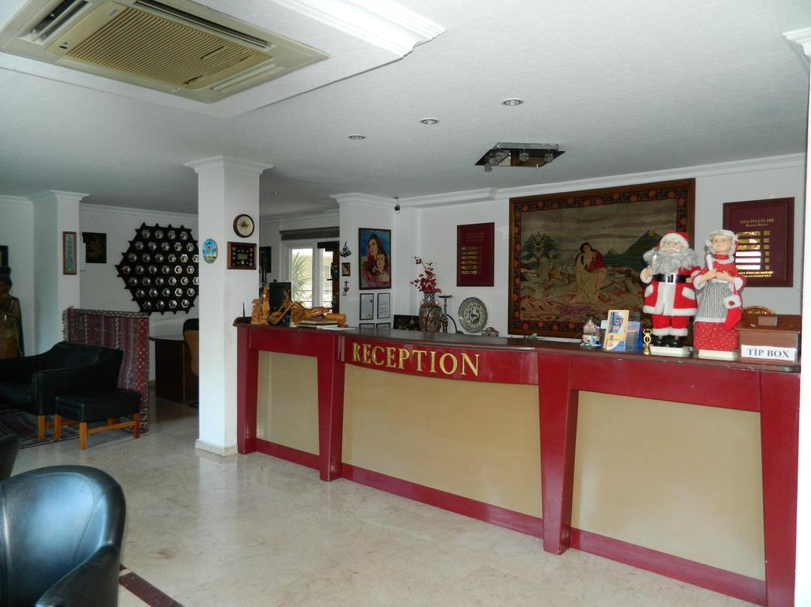

Slide 5
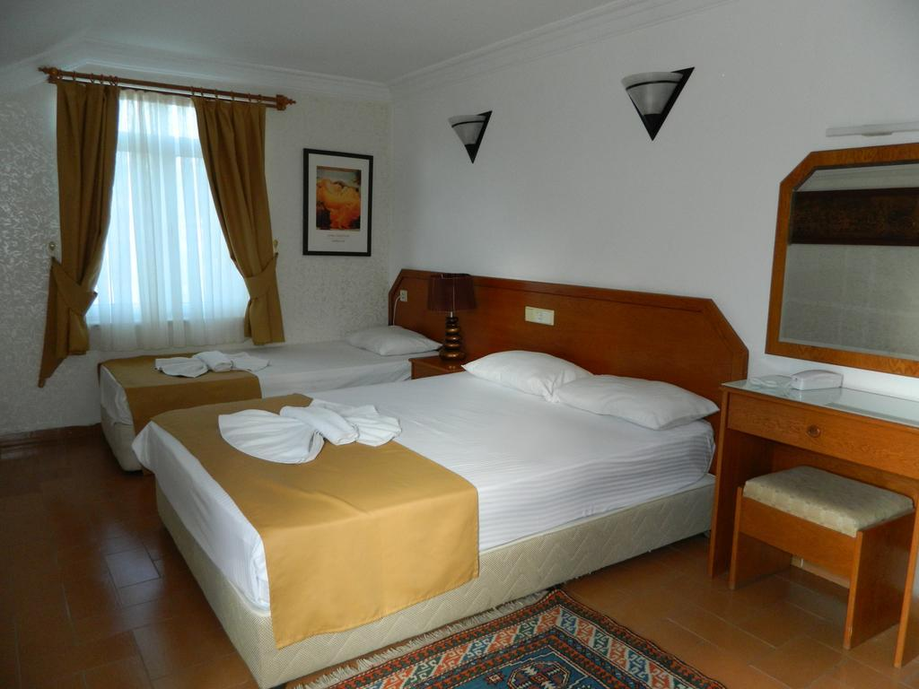
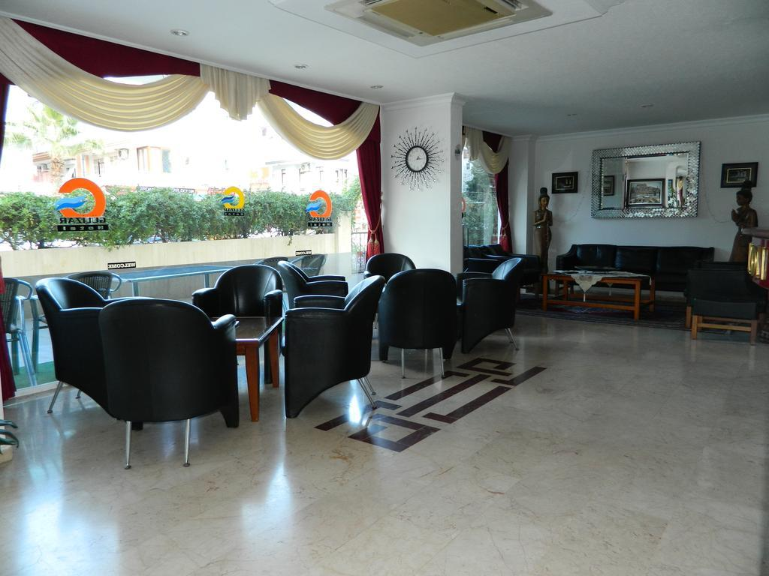

Slide 6
GUIDANCE We will provide English speaking guide for the group. He will be responsible all kinds of emergency. He/she will guide during job training, free time, cultural visits etc. We will give you an emergency situation contact number and he will help them in any case of emergency. .

Slide 7
TRANSPORT We organize the transport between organization that we will visit and hotel. We will organize transport between airport and hotel. We will provide transport for cultural visits. All the transports will be made a bus for the group. Hotel is at the city center, our guests will easily walk around the city after visits/trainings. There will be daily city tours. Transport will be provided by us. .

Slide 8
CULTURAL ACTIVITIES We want to make happy our guests so we organize free-time activities during the mobility. We will shall arrange in city cultural tours (beach, Düden waterfalls, some cultural places in city center etc.) according to the demand of participants at week days. We will organize at least 1 cultural tour at the weekends. Visit to Olympos, Phalesis, Side, Alania castle Perge etc… The meals and transport will be provided by us. The entrance fees are not under your responsibility. You can find attractive touristic places of Antalya at https://www.planetware.com/tourist-attractions-/antalya-tr-ant-at.htm .

Slide 9
MEALS Breakfasts are at the hotel. Lunchs are generally at at a cafe close to the hotel. Dinners are at a restaurant/cafe according to the groups’s location. For example if we are in a cultural visit to Alania, you will eat there. Alcoholic drinks are excluded. .

